Slide 1
Visual guide for installation instruction
For Mac OS X

Slide 2
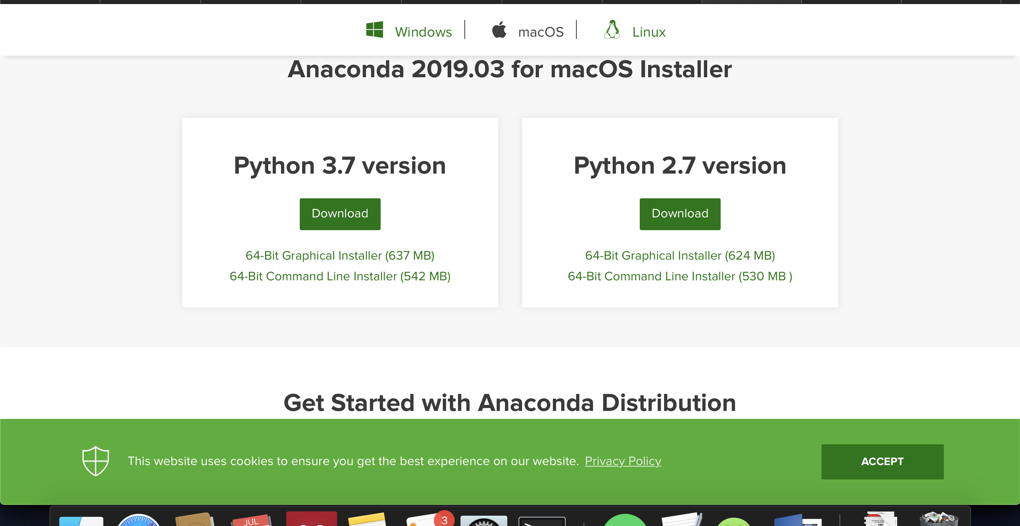
1. Download and install Anaconda
Go https://www.anaconda.com/distribution/ and click on Download Python 3.7 version
1
Hardware Recommendation:
CPU: i5 (64bit) or above
Memory: 4Gb or above
Internet enabled
MacOS admin right
2
Click here for the macOS version
Download here for Python 3.7

Slide 3
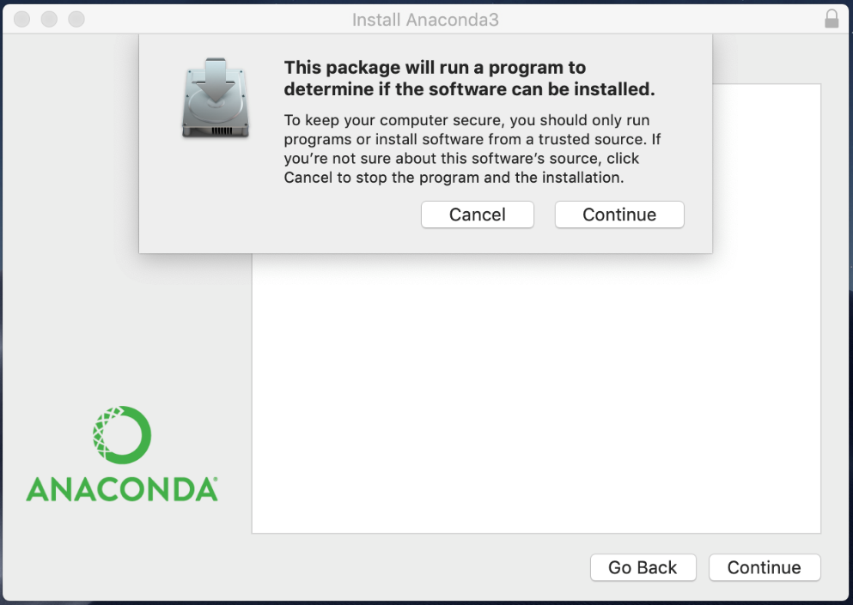
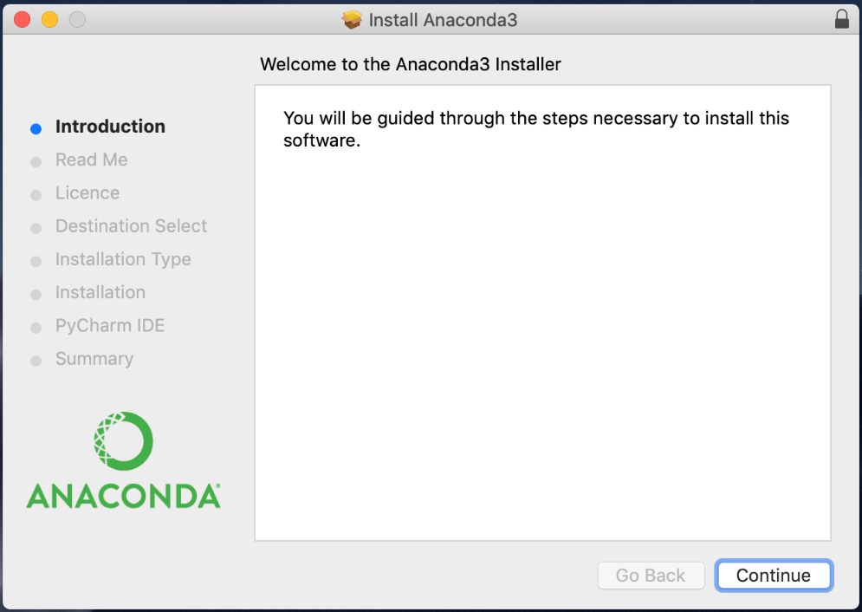
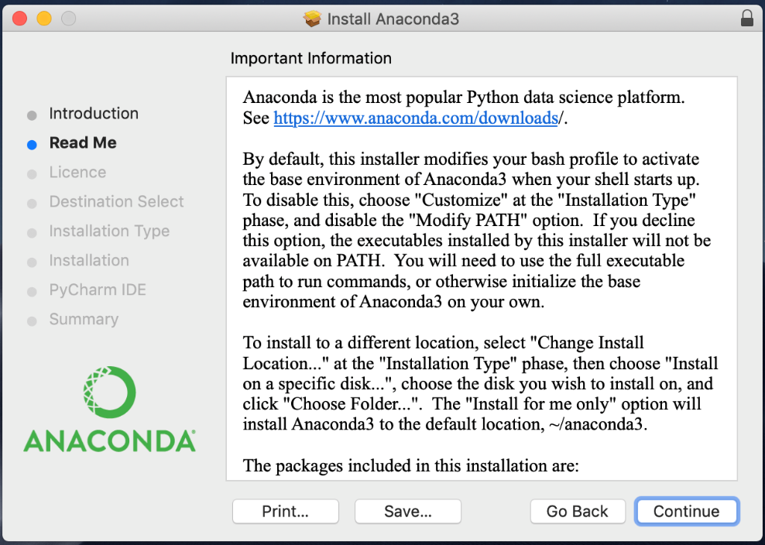
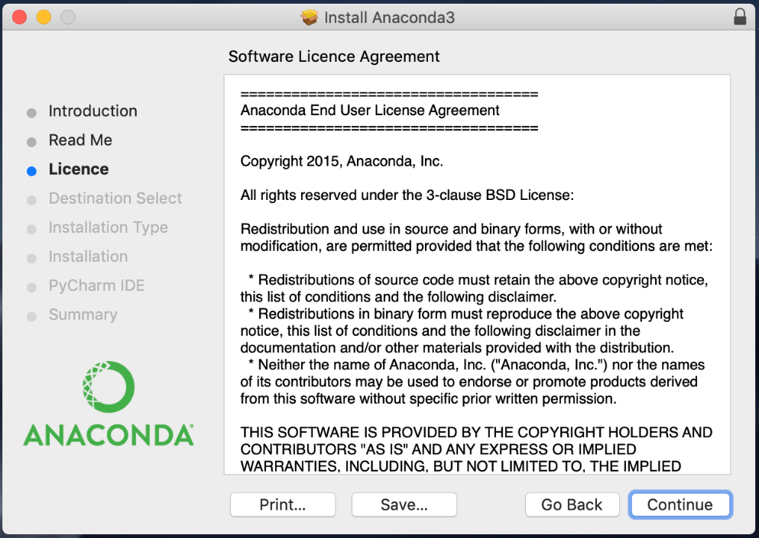
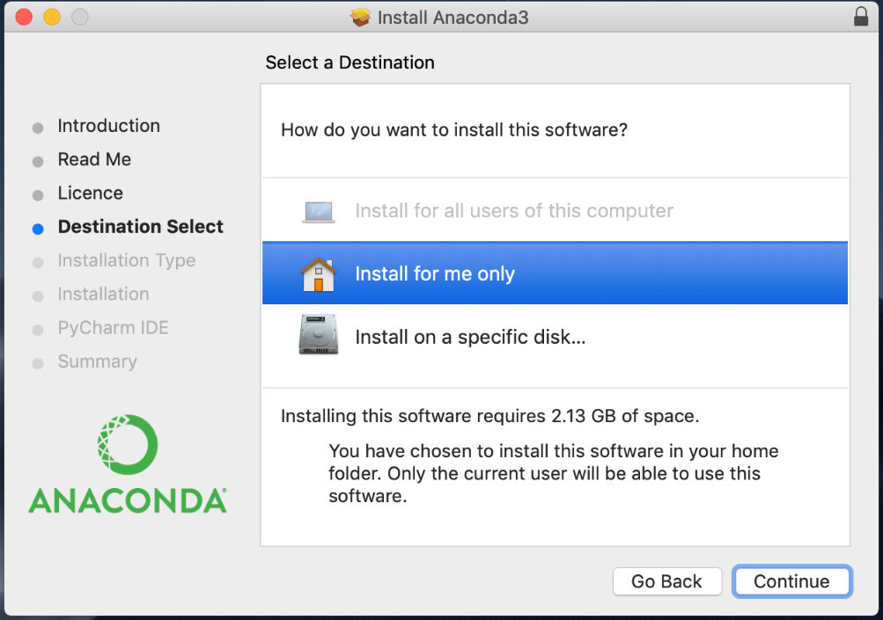
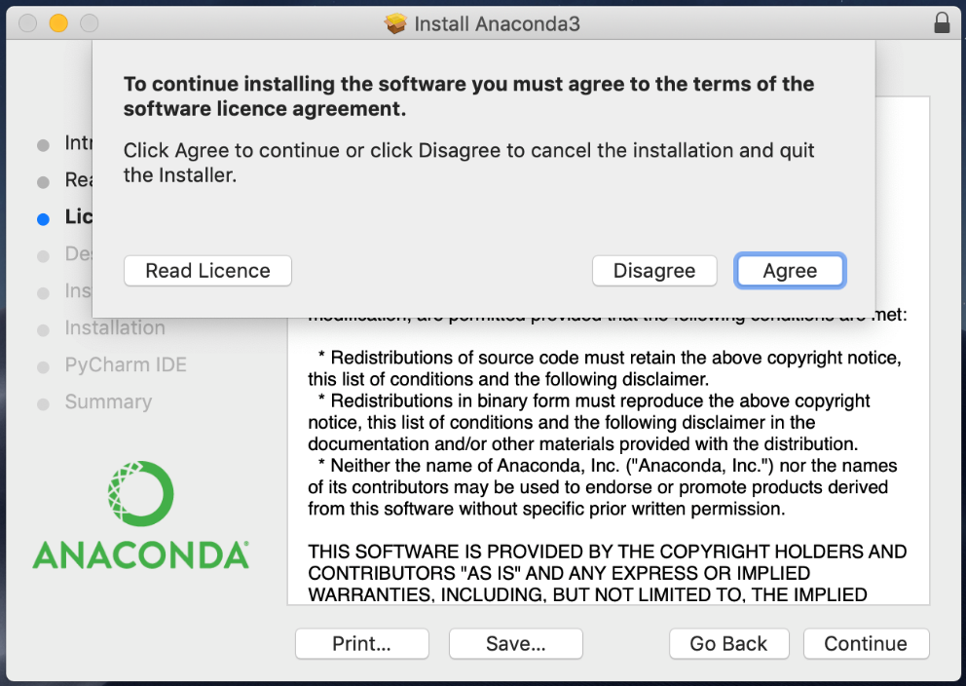
1. Download and install Anaconda
1
2
3
6
5
4

Slide 4
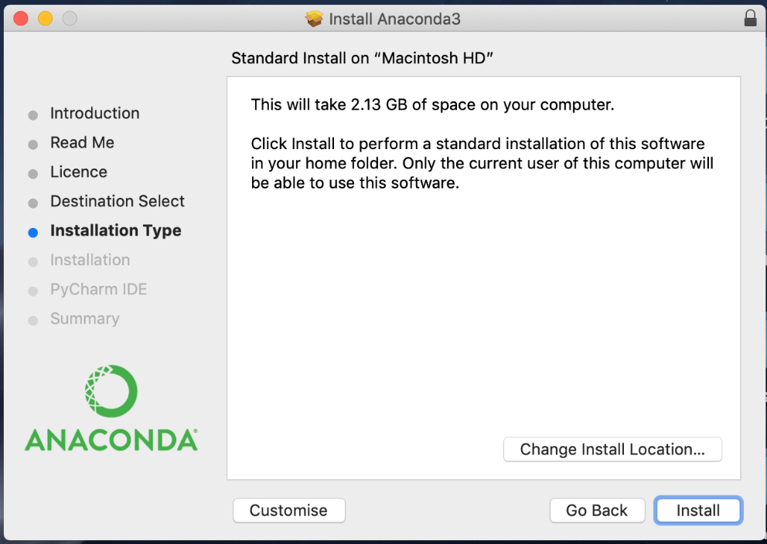
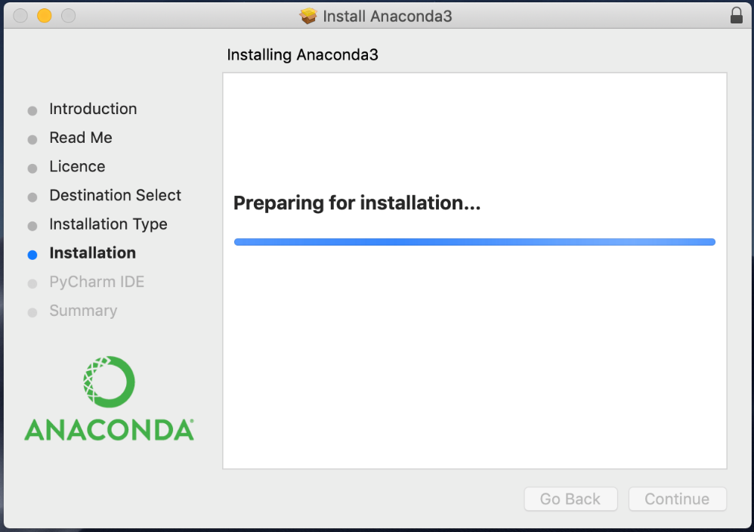
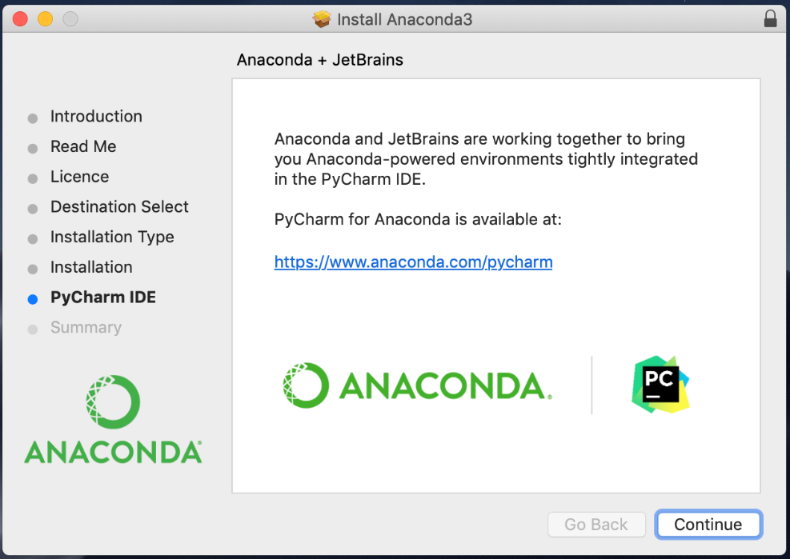
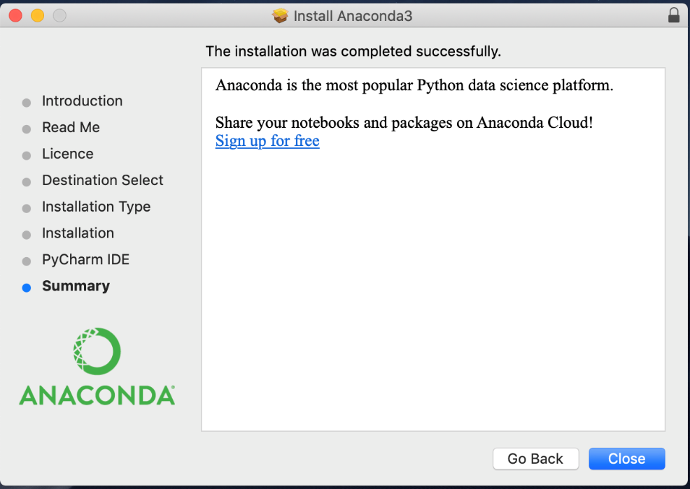
1. Download and install Anaconda
8
7
9
10

Slide 5
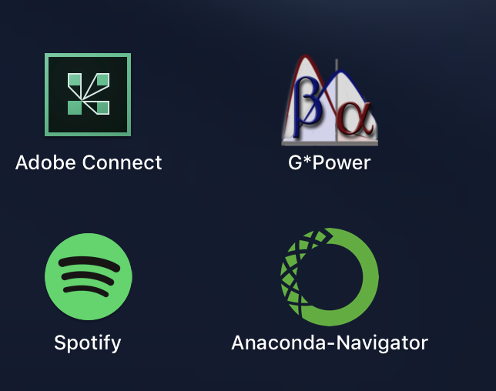
1. Download and install Anaconda
Make sure you see the Anaconda Navigator Icon in your Launchpad
Now you have installed Anaconda

Slide 6
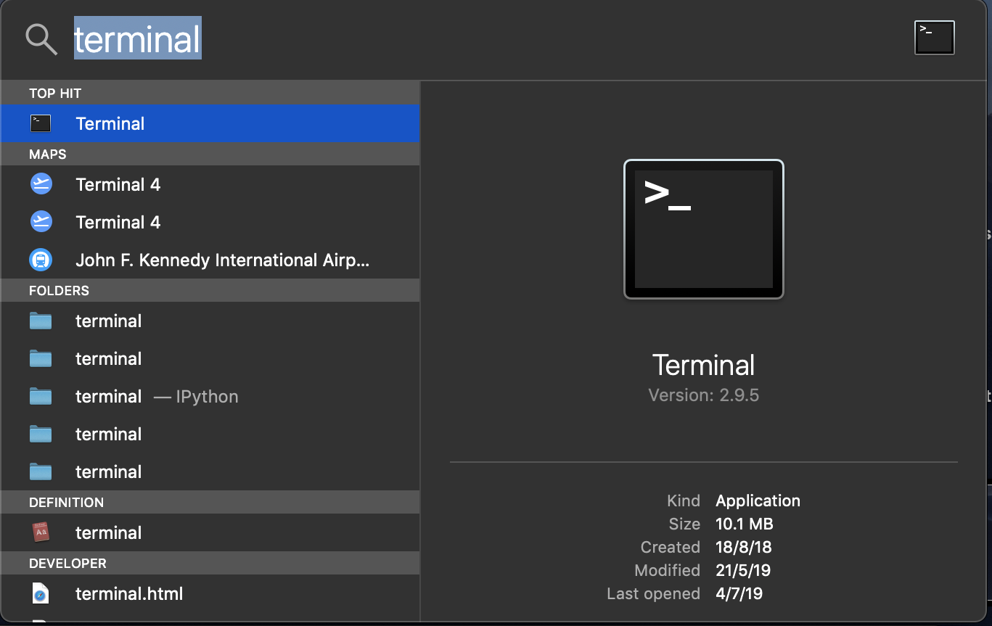
1.1 Open the macOS terminal
Cmd+Space bar to open Spotlight search
Type ‘terminal’ and open it

Slide 7
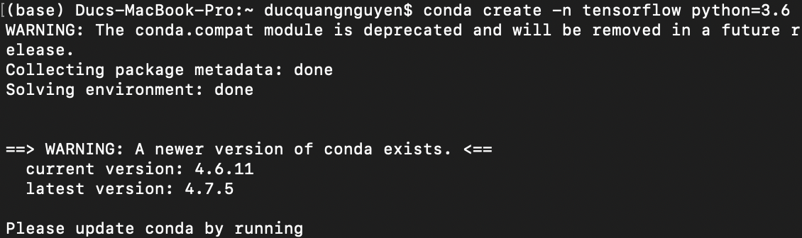
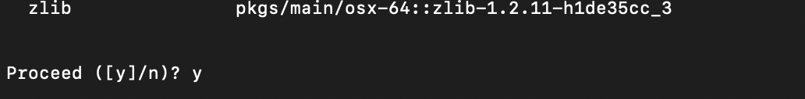
2. Create a Tensorflow environment in terminal
conda create –n tensorflow python=3.6
Please wait for the installation to complete
Note that we have to key in ‘y’ in order to proceed with installation
Type this line into terminal

Slide 8
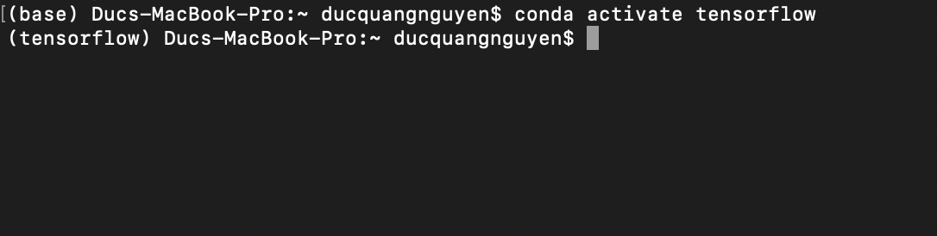
3. Activate your new environment:
Type this line into terminal
conda activate tensorflow
You will see your prompt prepend (Tensorflow) to indicate that you are in your Tensorflow environment
Prepend here! Now you are in Tensorflow

Slide 9
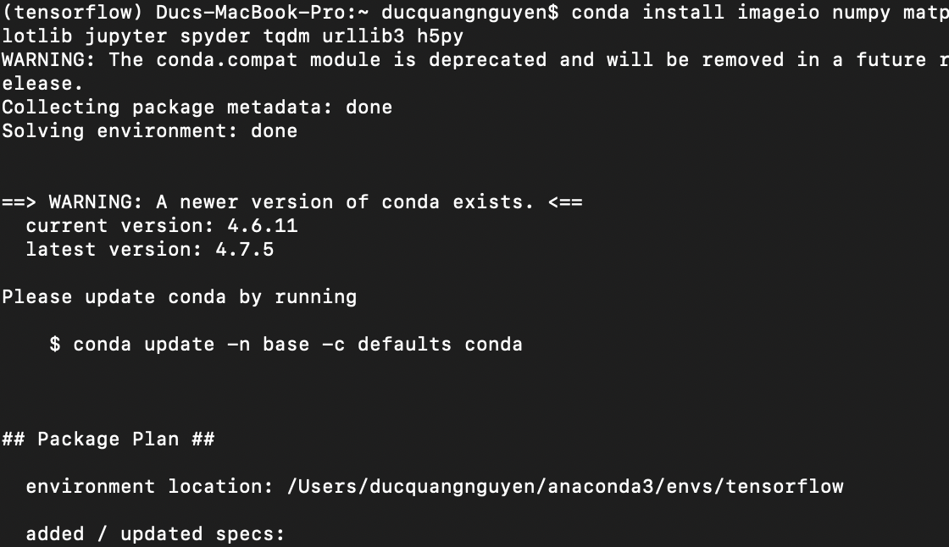
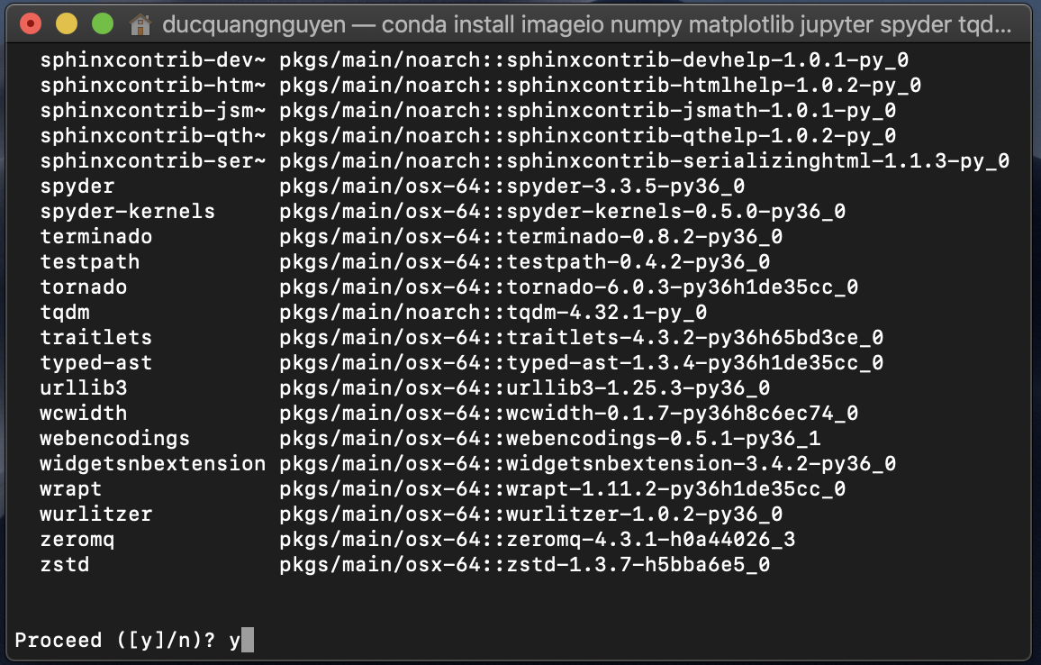
4. Install some prerequisite packages
conda install imageio numpy matplotlib jupyter spyder tqdm urllib3 h5py
to key in ‘y’
Type this line into terminal
in Tensorflow environment you just activated

Slide 10
5. Install CPU version of TensorFlow
CPU
pip install --ignore-installed --upgrade https://storage.googleapis.com/tensorflow/mac/cpu/tensorflow-1.12.0-py3-none-any.whl
The above only applies to CPU version. For the purposes of this demo though, the CPU version is sufficient.
Type this line into terminal

Slide 11
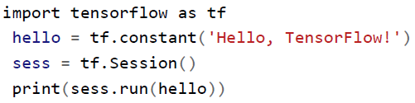
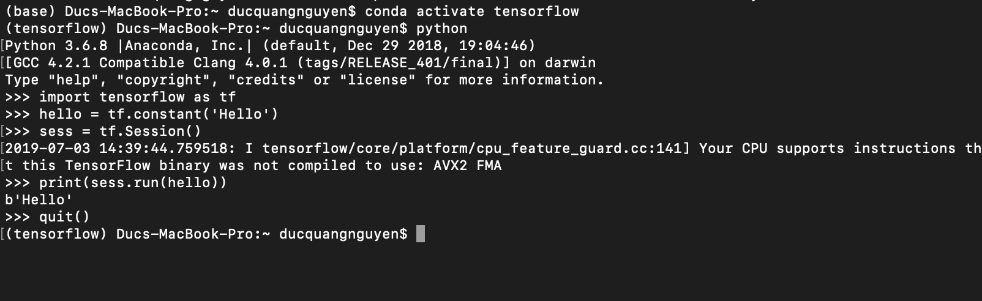
Verify TensorFlow Installation
Enter: python
Enter this program into your Python shell:
You just completed the installation!

